Slide 1
Embryo transfer (ET)
Embryo transfer is the process by which an embryo is collected (flushing) from one female (the donor) and transferred to another female (the recipient) to complete the gestation period.
The main goals for ET is obtain the maximum number of genetically superior embryos in a minimum amount of time

Slide 2
Benefits of embryo transfer:
Cows produce only one calf per year, ET allows the production of many offspring within a year from a single cow
ET can increase the genetic potential of a herd in a relatively short period of time.
ET can increase milk production in dairy herds.
ET can increase weaning weights in beef and dairy herds.
ET allows other producers to take advantage of superior genetics because frozen embryos can be shipped almost anywhere and cross border.
ET preserves superior genetics for future generations due to embryo freezing.

Slide 3
Disadvantages of ET
Increased expenses and higher breakeven costs for calves
• Requires a higher level of management
• Increased potential for spread of certain diseases
• Not all potential donors respond positively to treatment

Slide 4
Embryo transfer
    The main steps for embryo transfer:
      1- Selection of donors
      2- Selection of recipients
      3- Estrus Synchronization of donor and recipient animals
      4- Superovulation of donor animal
      5- Artificial insemination of the donor animal
      6- Embryos collection
      7- Evaluation of embryos
      8- Transfer of embryos to recipient animal

Slide 5
Basics of donor cow selection
Regular estrus cycles
High milk production
Good body condition
Maximum reproductive capacity
No previous report of reproductive problems or repeat breeder
No previous report of dystocia with normal postpartum history
The transfer of the genetic characteristics of the donor cow is the main objective for ET

Slide 6
Basics of recipient cow selection
Recipient cow serve as surrogate (foster) mothers to the calves, but not contribute with genetic information
The genetic makeup of the recipient cow is not as important as the makeup of the donor cow
The recipient cow must be able to maintain her pregnancy to term and produce an adequate milk supply for her calf.

Slide 7
The procedures of ET
Estrus synchronization
Once the donor and recipient cows have been selected, they must be synchronized so they are on the same phase of their estrus cycle
It is important to synchronize estrus cycles because the reproductive environments of the donor and recipients must be identical in order for the embryo to survive the transfer
Estrus synchronization programs we described previously

Slide 8
The procedures of ET
Superovulation
The donor cows introduce for superovulation programs for producing many follicles and oocytes instead of one oocytes
Superovulation programs we described previously

Slide 9
The procedures of ET
Breeding the Donor Cow
When the donor shows signs of estrus, directly inseminate naturally or artificially
Two inseminations are required and are performed 12 hours apart
Use high quality semen
It is important to evaluate the semen before insemination
In the case of natural insemination, it is necessary to use males known to have high fertility

Slide 10
The procedures of ET
The Flush:
Once the donor cow has been bred, the embryos are allowed to grow for six days
During this time the embryos travels down the reproductive tract from the oviduct to the uterus where they can be flushed out
On the seventh day, the embryos are ready to be removed, this process is called flushing
Two methods for flushing, either surgical method or non-surgical method

Slide 11
The procedures of ET
The Flush:
  Non-surgical method: as following:
1-An injection of lidocaine is given prior to the flush to reduce pressure and stress on the donor cow and to make the flush easier
2-To begin the flush, a Foley’s catheter is passed through the cervix into one uterine horn.
3-The Foley’s catheter contains a balloon that is inflated inside the uterine horn to prevent the flushing fluid (phosphate buffered saline) and embryos from escaping through the cervix

Slide 12
The procedures of ET
The Flush:
  Non-surgical method
4-After that the uterine horn filled with flush media and massaged to allow the embryos to flow out of the tract
5- This process is repeated several times in each uterine horn to ensure removing all the embryos from the uterus
6- Embryos are carried out of the reproductive tract through plastic tubes and collected in a filter with the flush media.

Slide 13
The procedures of ET
The Flush:
  Non-surgical method
7-In the lab, embryos are separated from the flush media and examined under a microscope to determine their quality and stage of development
8-Only good quality and undamaged embryos should be transferred to the surrogate mother

Slide 14
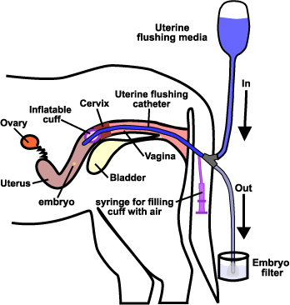

Slide 15
The procedures of ET
The Flush:
  surgical method
The surgical method most often used in sheep, goats, and pigs
Exposing the reproductive tract by a mid-ventral incision under general anesthesia.
Injection of flushing media directly for reproductive system
Three methods for collection embryos
  Flushing oviduct toward fimbriae
  Flushing oviduct toward utero-tubal junction
  Flushing uterus toward base of the uterine horn

Slide 16
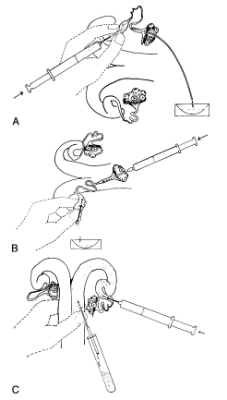

Slide 17
The procedures of ET
Transferring the Embryos
Each embryo which collected put into a small, plastic straw and then loaded into an embryo transfer gun
The embryo is then inserted through vagina into either the left or right uterine horn of recipient cow depending on which ovary has a corpus luteum
Or the insertion of embryo can be done by laparoscope
After that the donor cow should be injected with prostaglandin to prevent pregnancy if you missed embryos after flushing as well as antibiotic to prevent any infection which may be happened after flushing

Slide 18
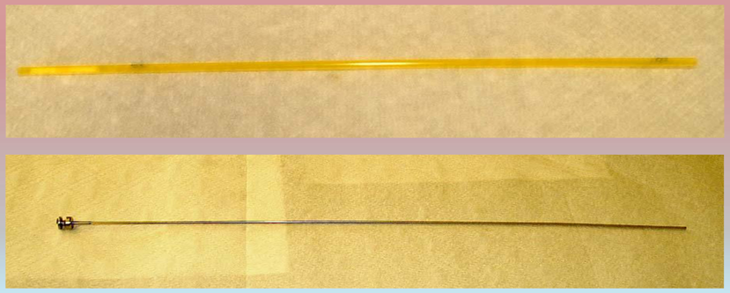

Slide 19
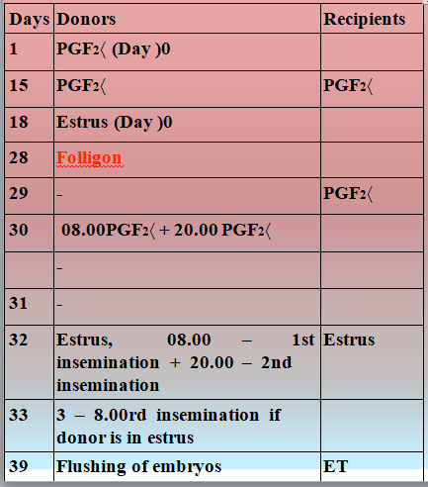

Slide 20
